Slide 1
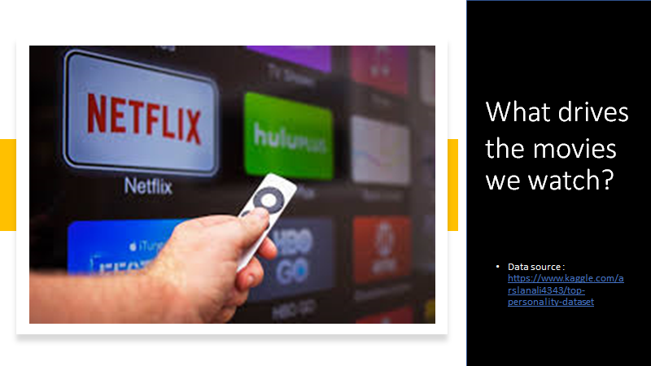
Group 5: Elissa Carroll, Sok Leng Chan, Marboobeh Hosseini, Katie Pierce
Notes:
For the dataset we chose, the authors of the study asked the question: What drives people’s choices in the movies they watch?

Slide 2


Openness
Extraversion
Conscientiousness
Emotional Stability
Agreeableness
7
1
Notes:
To answer this question, they chose to look at the effects of personality traits on the likelihood that users would rate movies highly or not.
Each user took a personality test and was assigned a score of 1-7 for each of five different personality traits.
They were then given 12 movies to watch and based on their preference for those movies were assigned one of four metrics: Serendipity, Popularity, Diversity, Default.
For each of these metrics they were also evaluated on how strongly they aligned with that metric. Each user was given an Assigned Condition of High, Medium, or Low depending on this.
The assigned metric and assigned condition were combined to determine the list of movies that was given to each user

Slide 3
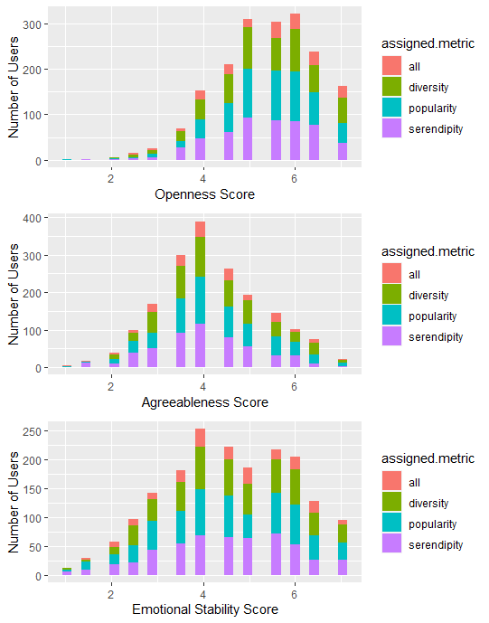
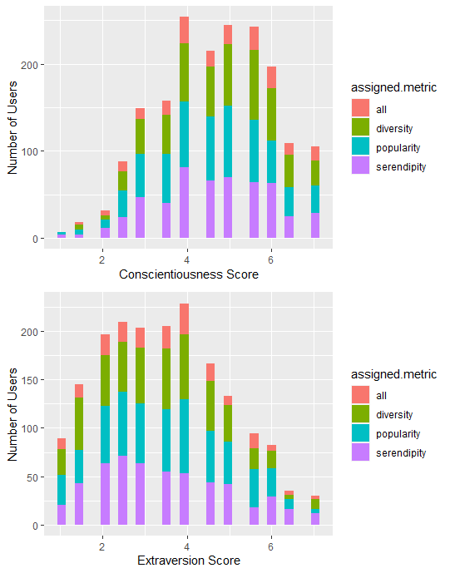
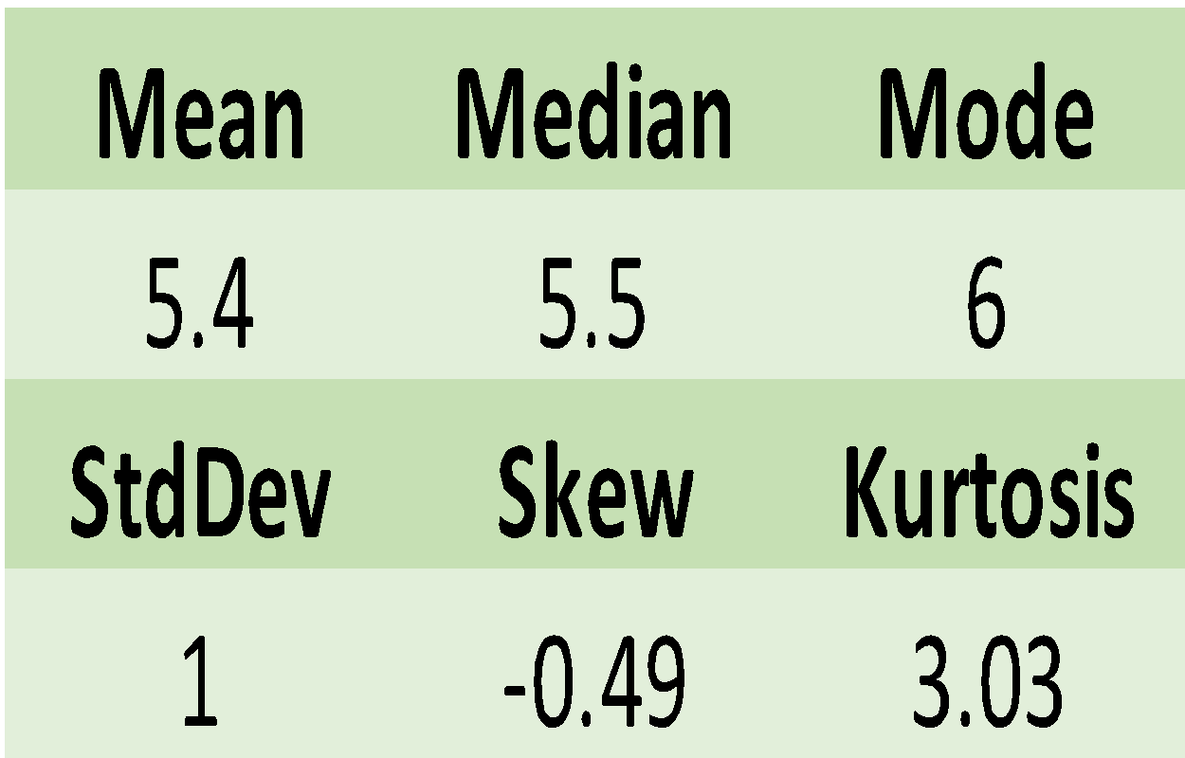
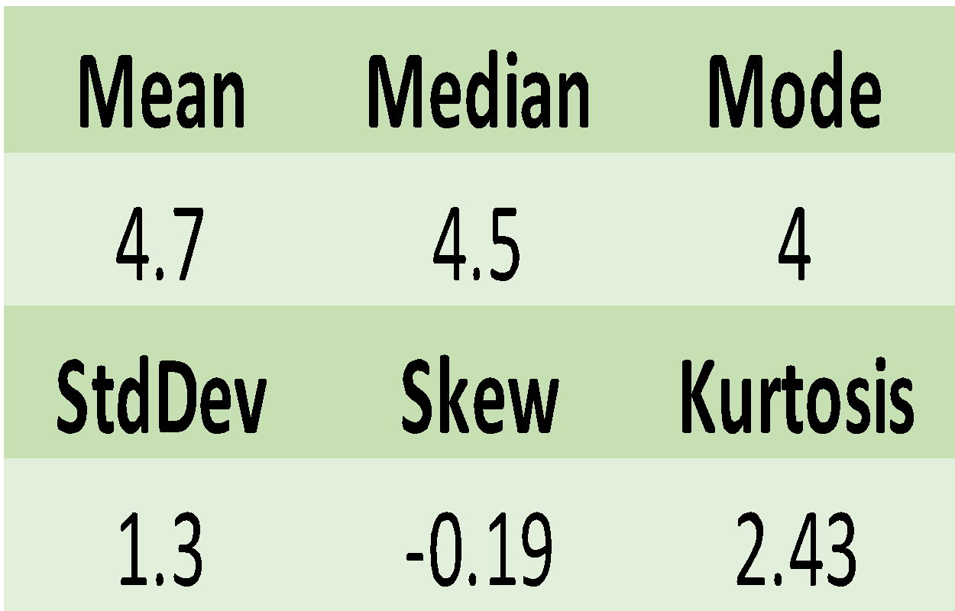
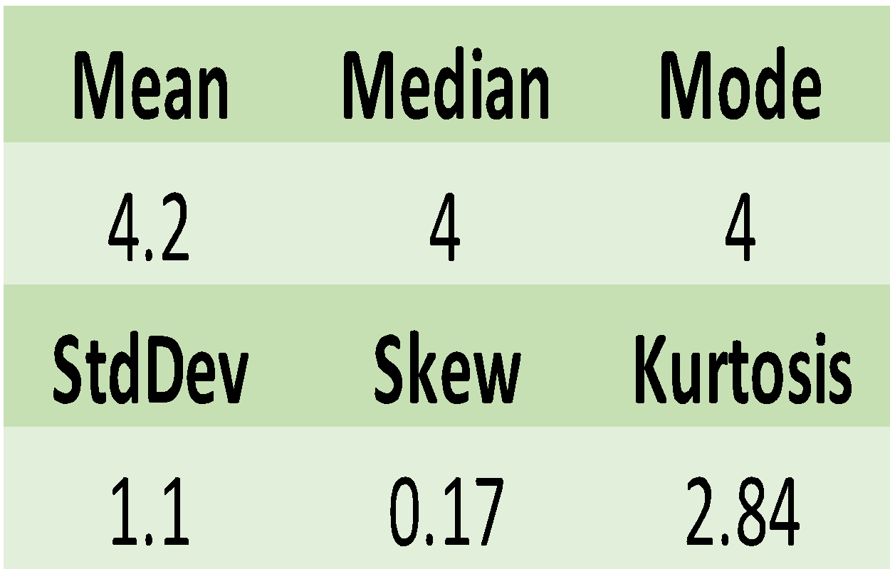
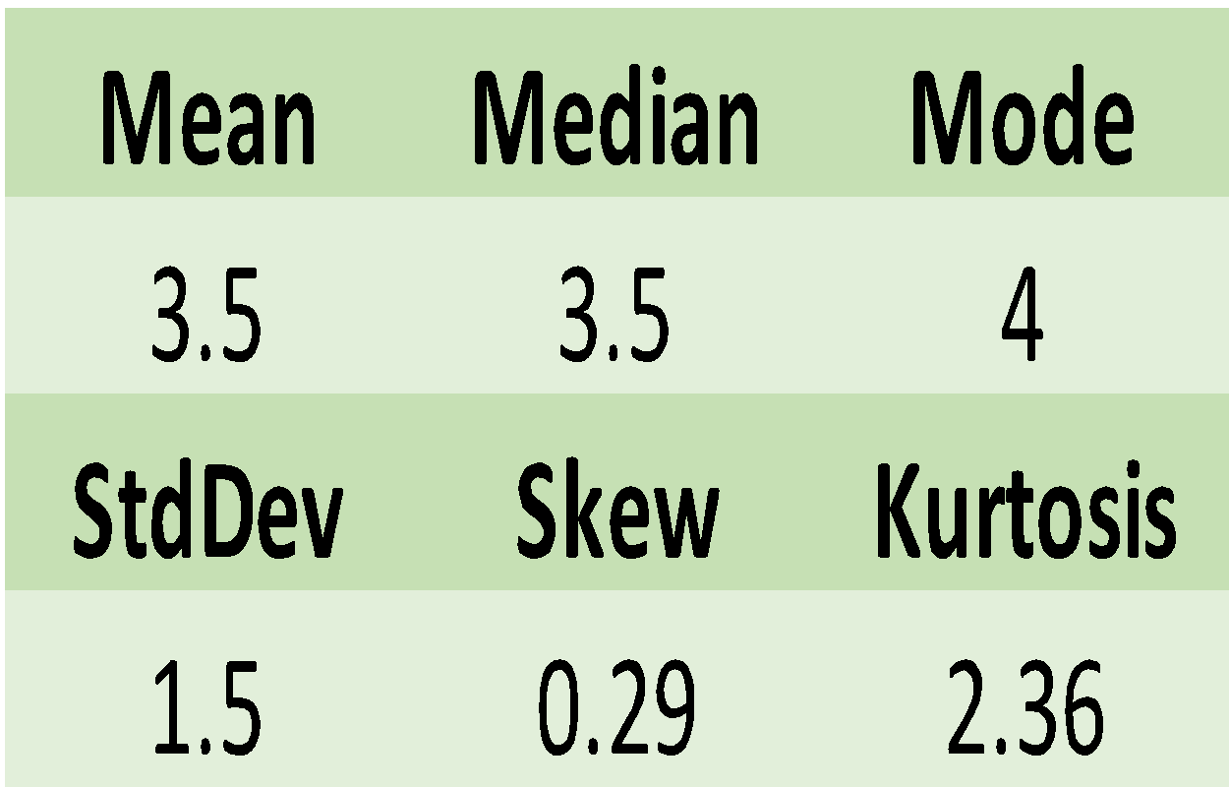
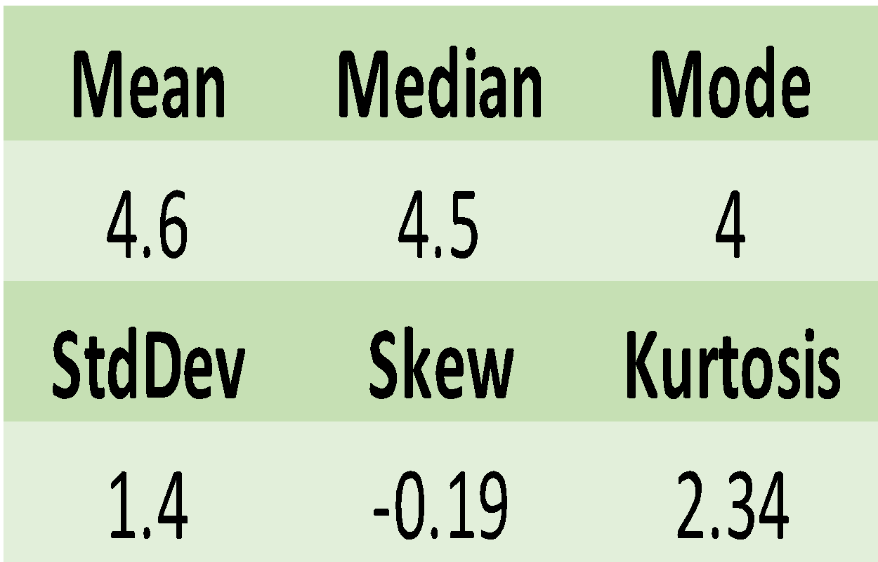
Personality Traits Across Users

Slide 4
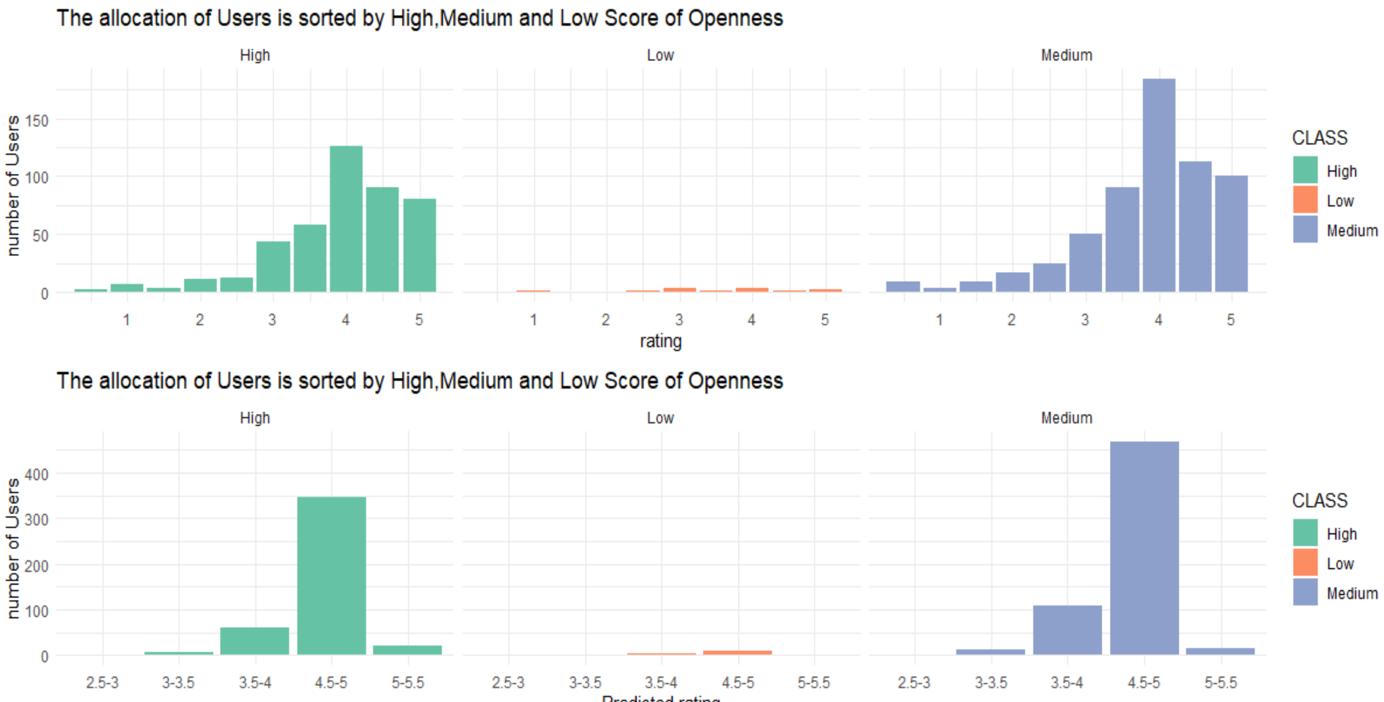
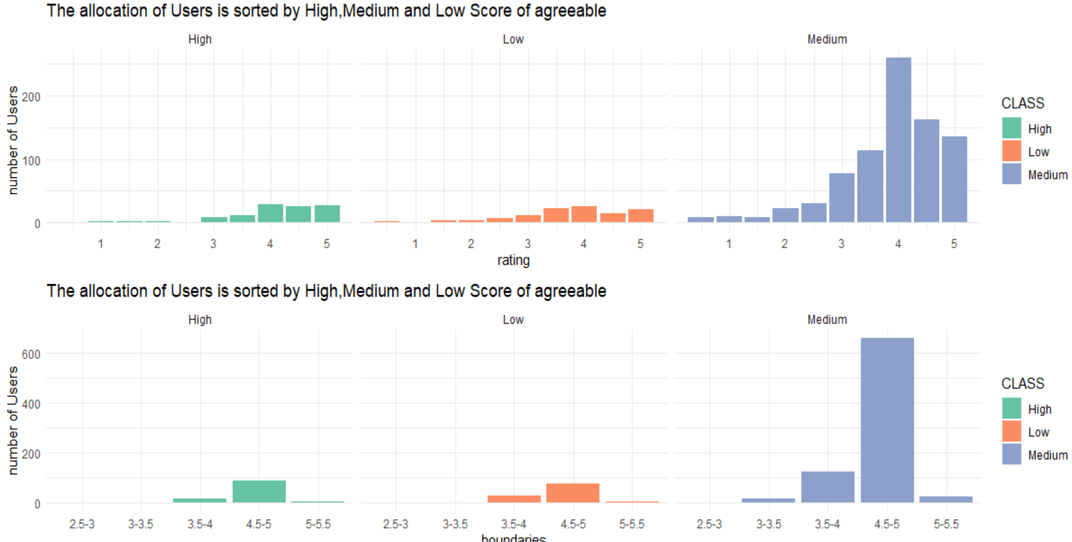
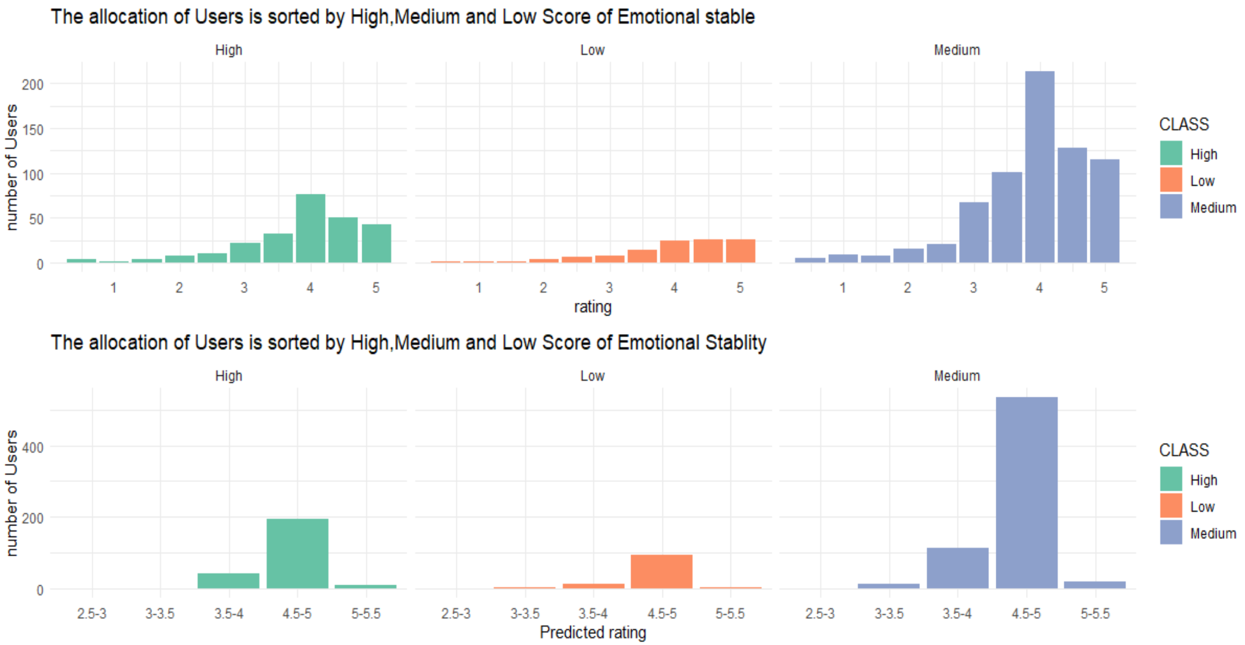
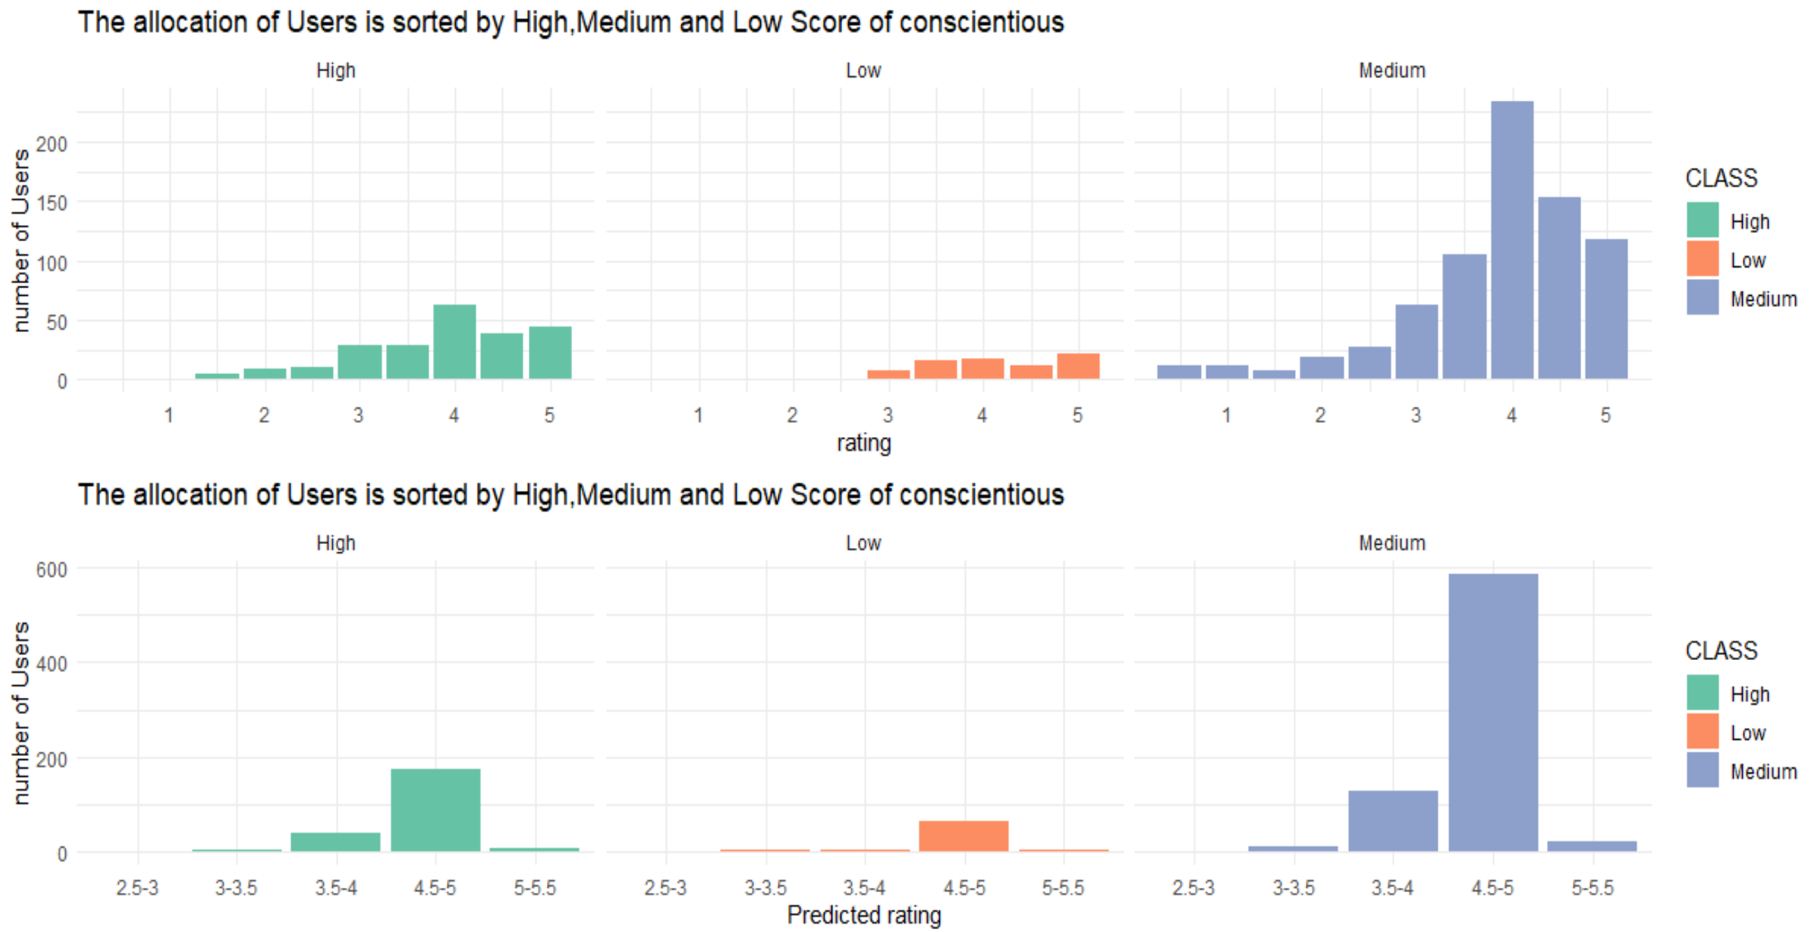
Notes:
For these diagrams, we want to compare each type of personality to actual vs. predicated rate. As we can see the distribution of each type of personality. We are able to observe medium is the largest portion of each type of personality, except extraversion and openness. Openness has two larger portion including high and medium class. It indicate openness users who scored above average , their predicate rate is closer to actual rate. Other type of personality also revels the similarity between actual rate and predicted rate. More specifically, when someone were to scores highly in any one of the personality traits, the likelihood of the predicted rating mirroring the actual rating increases.

Slide 5
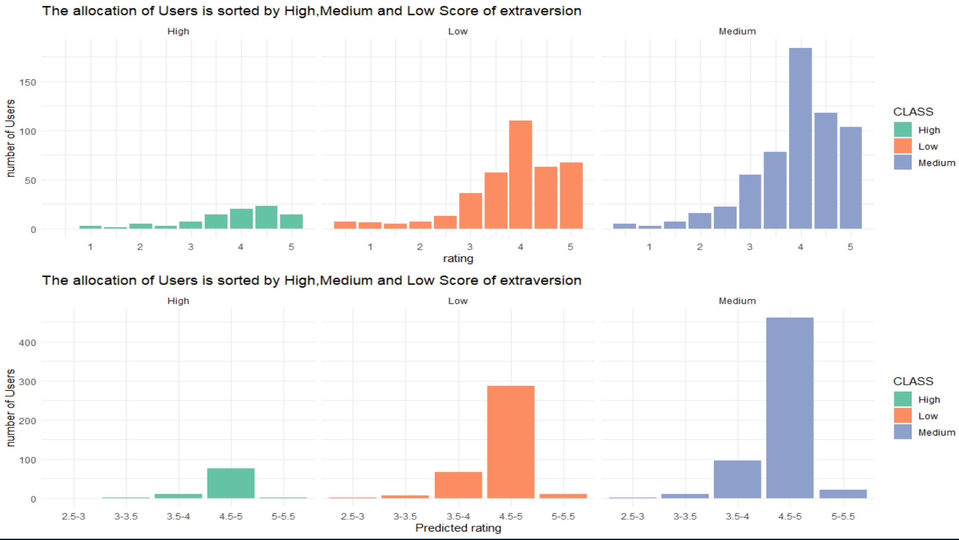
For this extraversion diagram, the distribution also focus on the medium class(Score 3-5), but second portion is low class(Score less than3). Overall, Majority portion of users was Medium class. It reveals no matter what type of personality you are; the predicted rate is similar the actual rate in this dataset. The type of personality doesn’t have huge effect on actual rate and predicted rate.

Slide 6
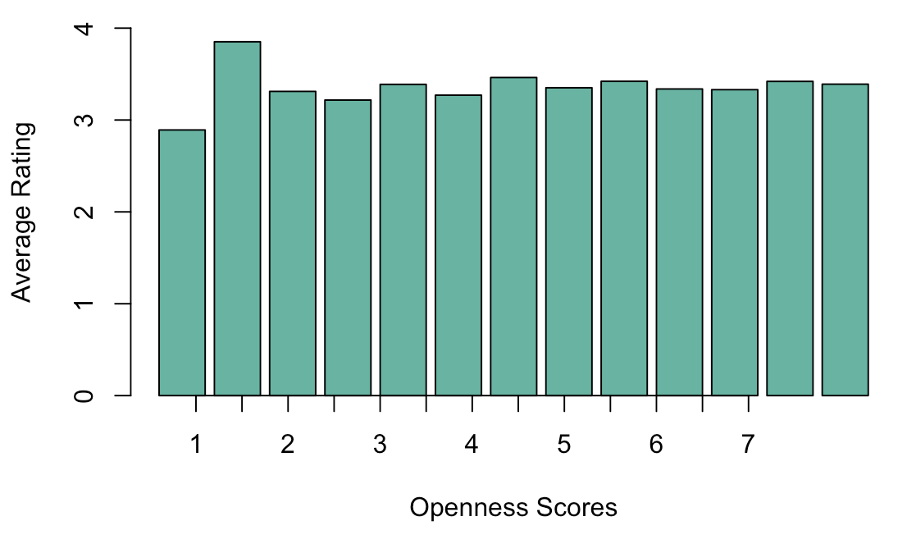
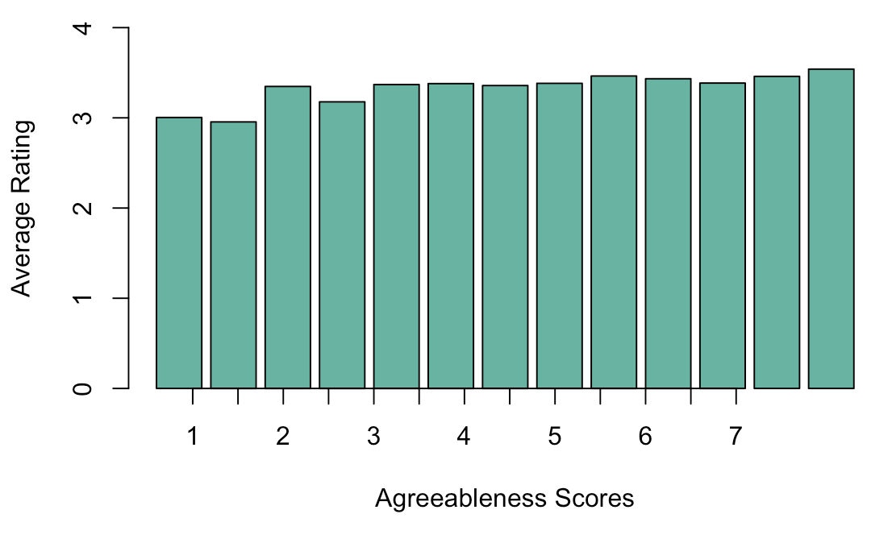
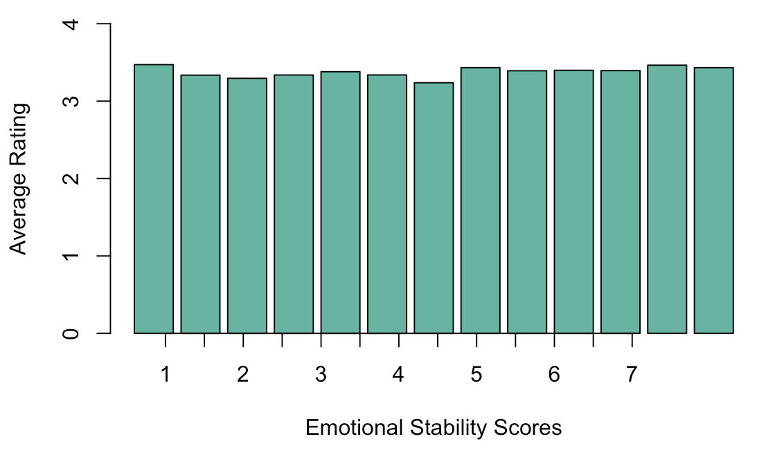
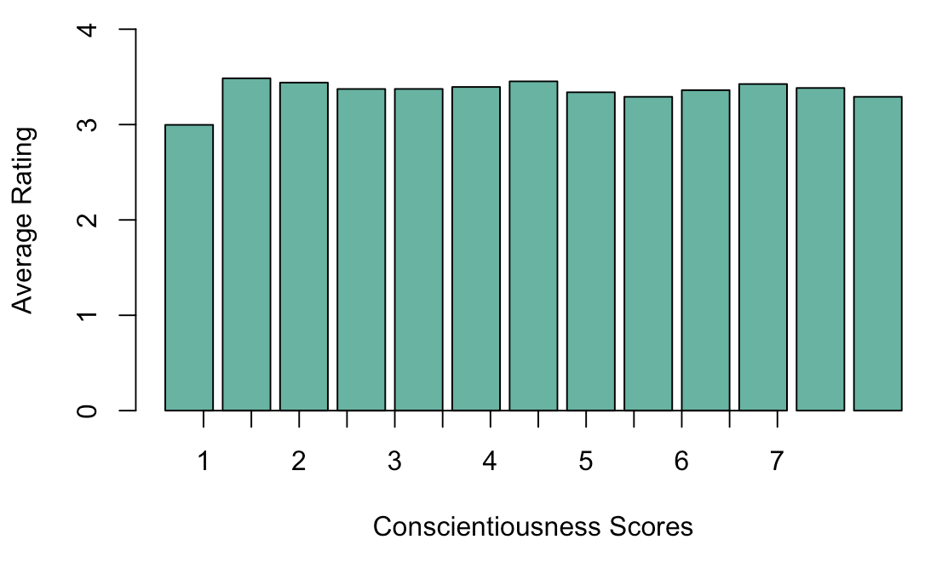
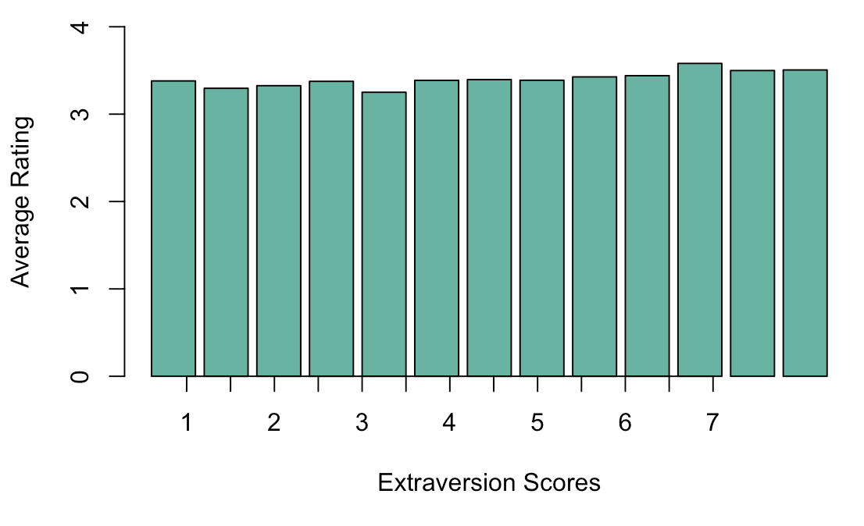
Users with High Ratings
Average ratings uniform throughout personality trait distributions
Personality cannot be used to predict high/low ratings

Slide 7
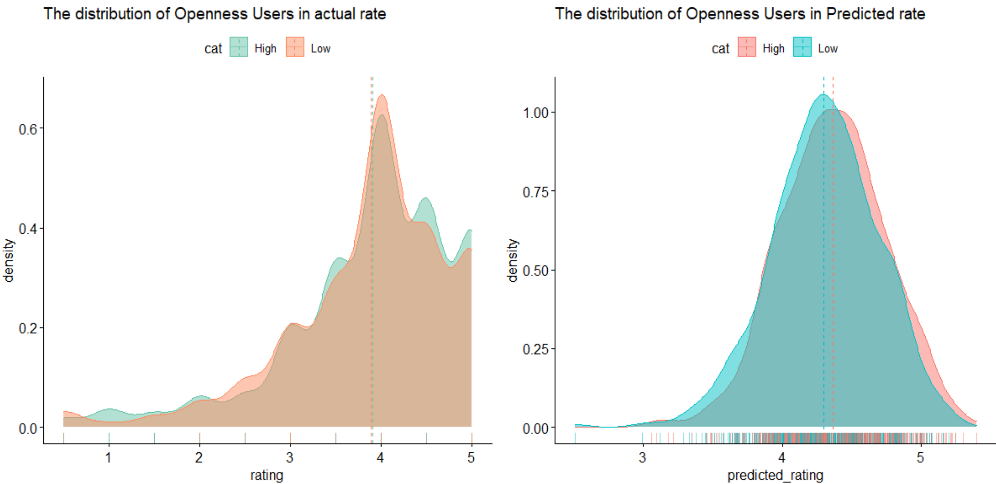
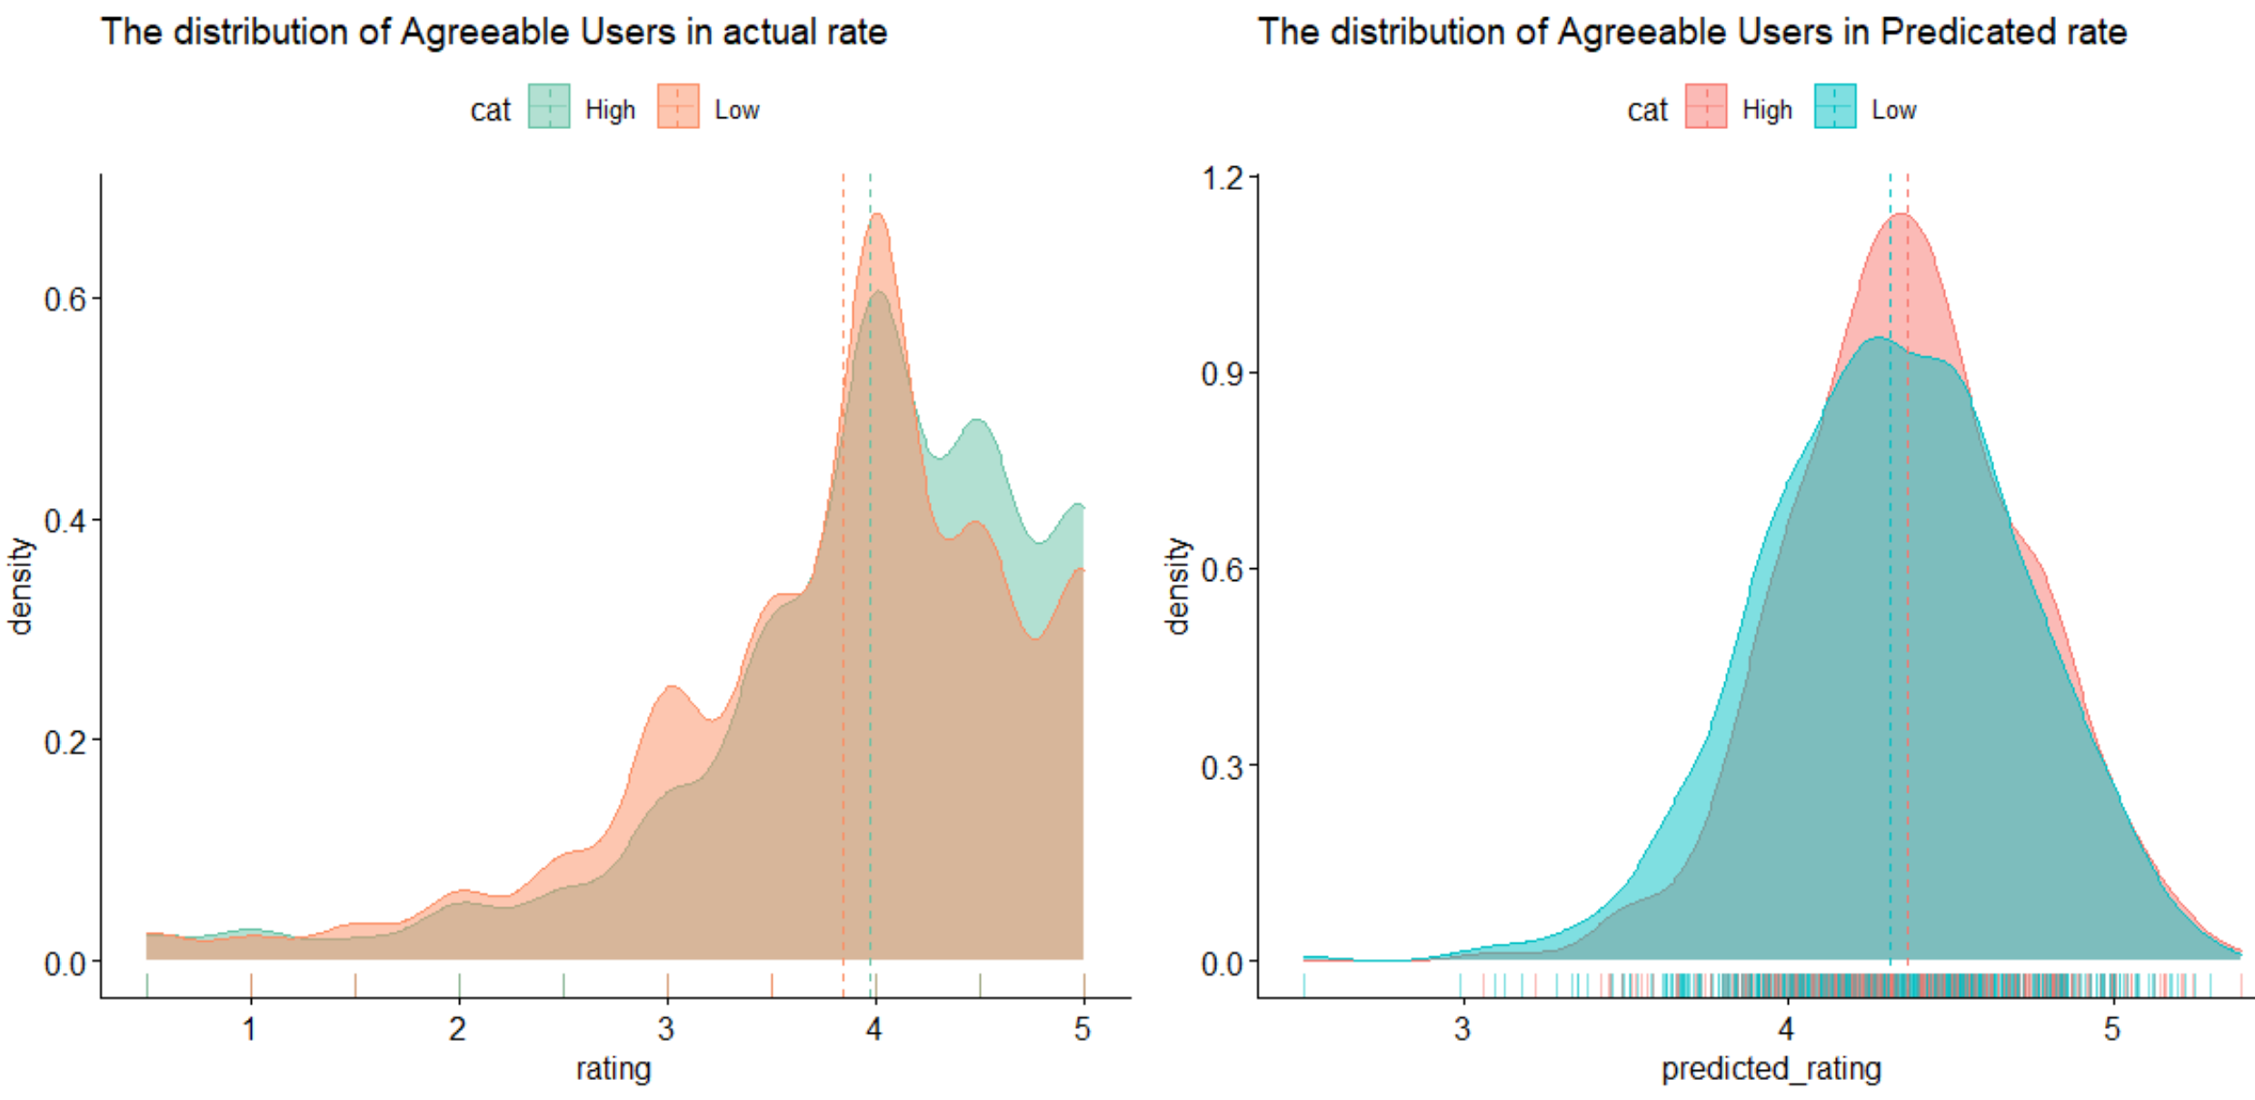
After comparing ratings within personality traits, we compared ratings for high/low scores in the personality traits and again found no differences in ratings
These diagrams were categorized by higher and lower group ( greater or lower than average of personality type.)
The vertical dashed lines represent the mean for each of the personality traits depicted. We are looking at density plots of high and low scoring users’ ratings.
In these diagrams, we observe the peak of each type of personality is very near to mean. They stand between score 4 and 5. It validate the similarity of actual rate and predicted rate again.

Slide 8
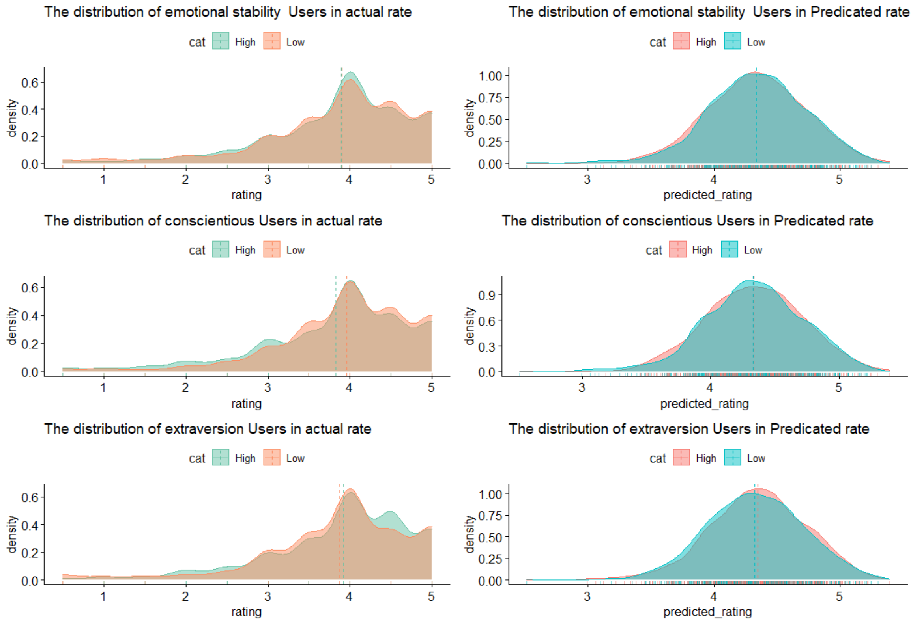

Slide 9
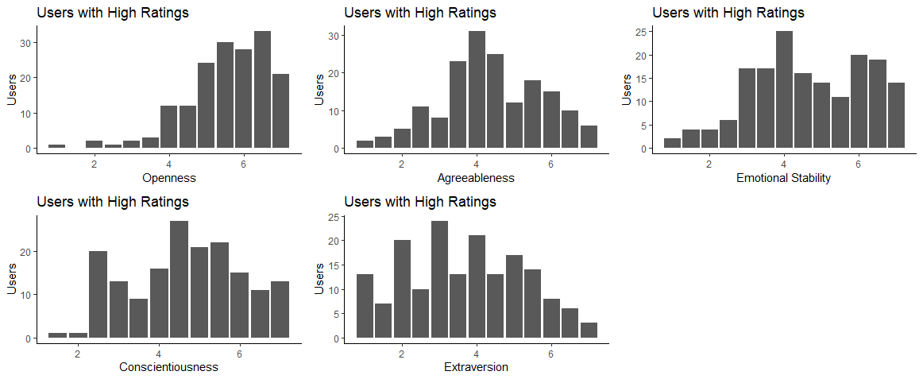
Users with High Ratings
Users with 100+ ratings of 5
Distributions of personality traits very similar to distributions for entire population
Users with high ratings are indistinguishable from average users

Slide 10
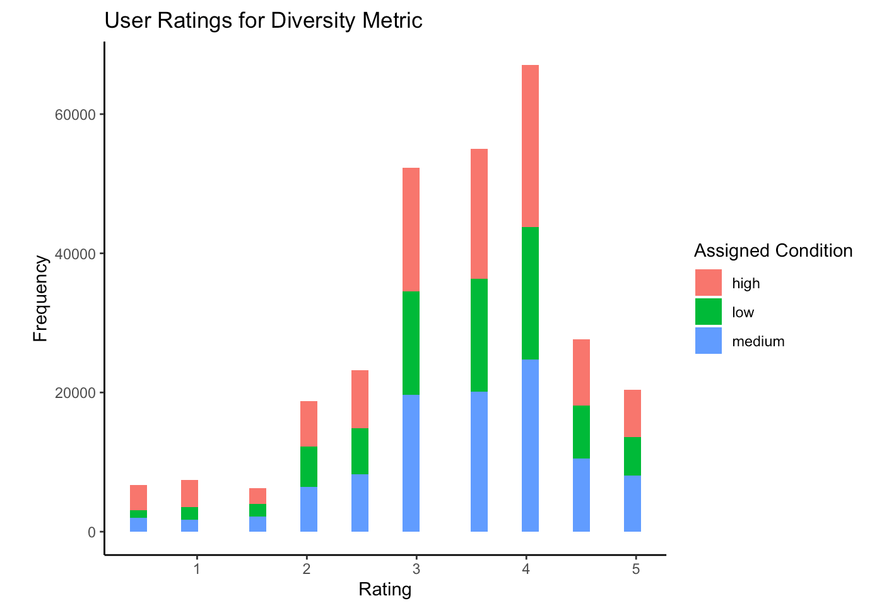
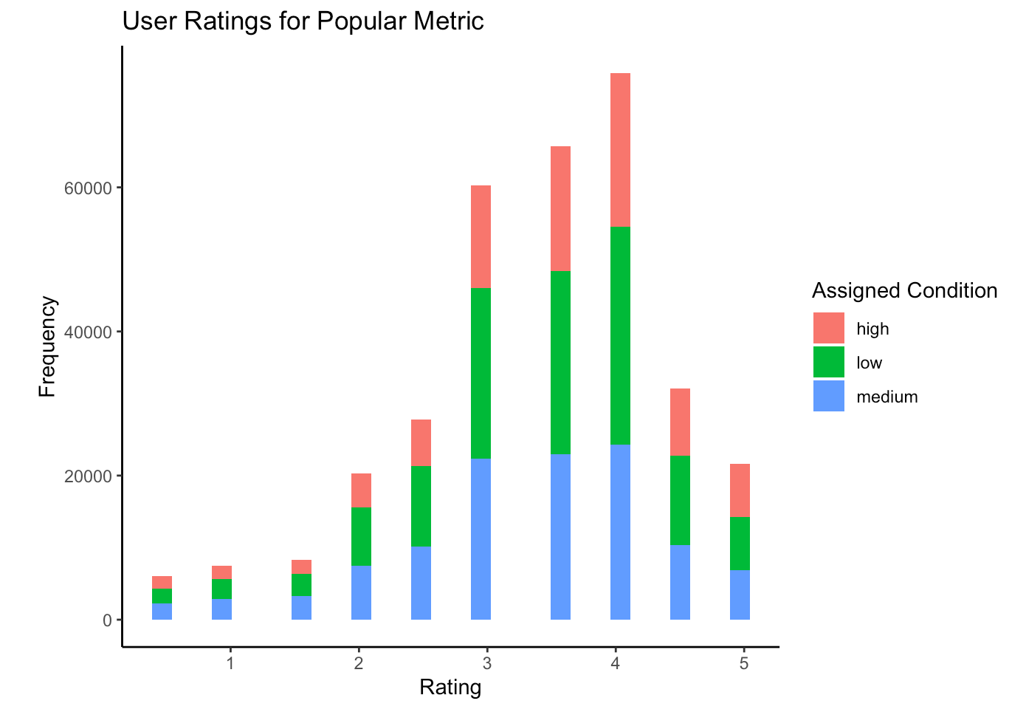
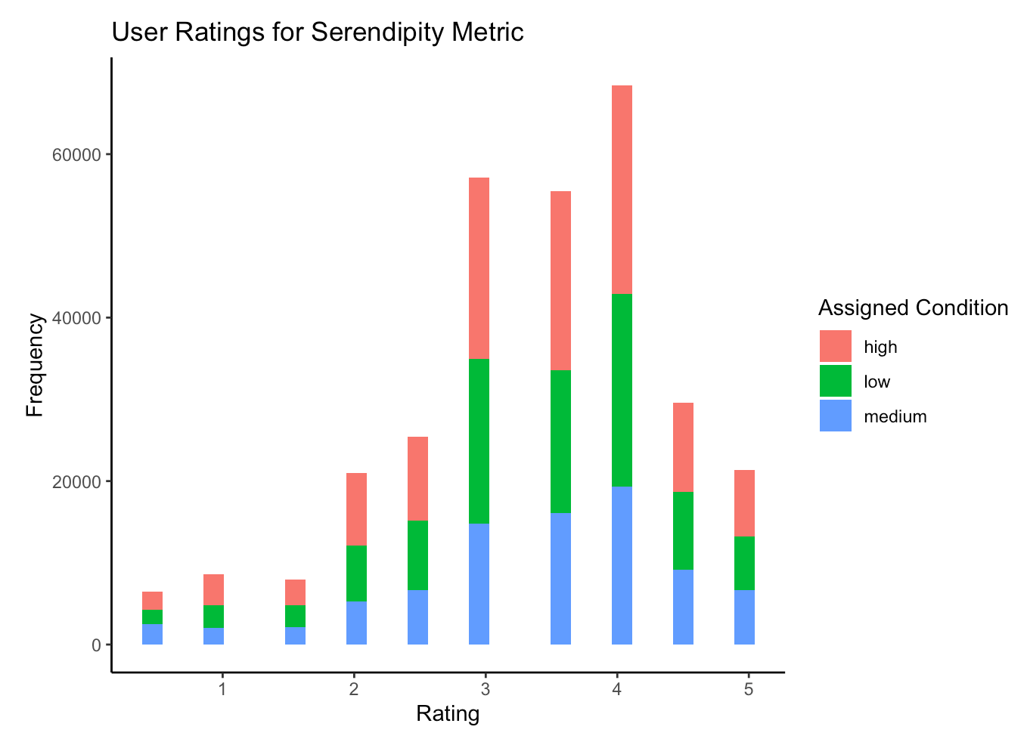
Affect of Assigned Metric on User Ratings
From the distributions of ratings for each assigned metric, it does not appear that the assigned condition yielded higher ratings. The percentage of ratings for high, low, and medium assigned conditions were consistent throughout the distributions of ratings.

Slide 11
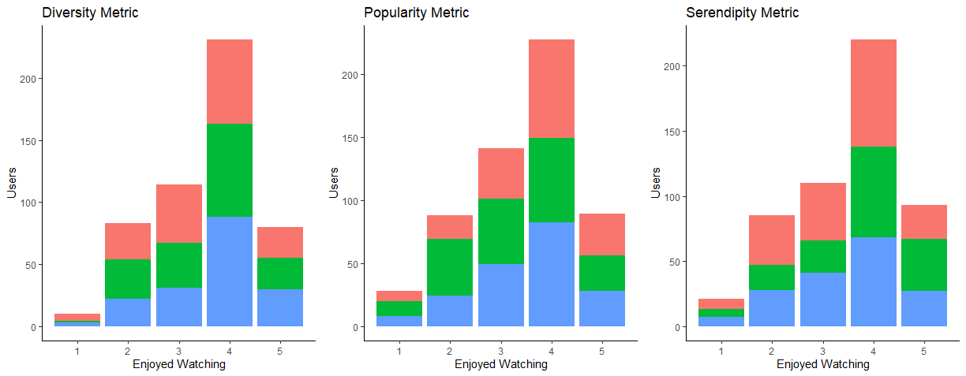
Assigned Condition and User Satisfaction
Neither assigned metric nor assigned condition appear to influence user satisfaction
An alternative conclusion is while the assigned condition does not play a major role in user satisfaction, it does have enough of an impact and merits further analysis.
Medium Condition dominates in high enjoy watching score
Medium & High Condition dominates
high enjoy watching score
Low & High dominates in high enjoy watching score

Slide 12


How Assigned Condition on Recommended movies changes people rating and enjoy watching ?
As we compare the rating vs enjoy watching score by the assigned condition, the results can prove us that if people highly rate a movie it does not mean they enjoyed it the most.
Popular Movies
Diverse Movies
Serendipitous Movies
Low → not Famous movie
Medium → Sort of different from other movies
High → very unexpected
Medium & high → well known movies
High → very unexpected
Low → very low degree of surprise
Medium → Sort of different from other movies

Slide 13
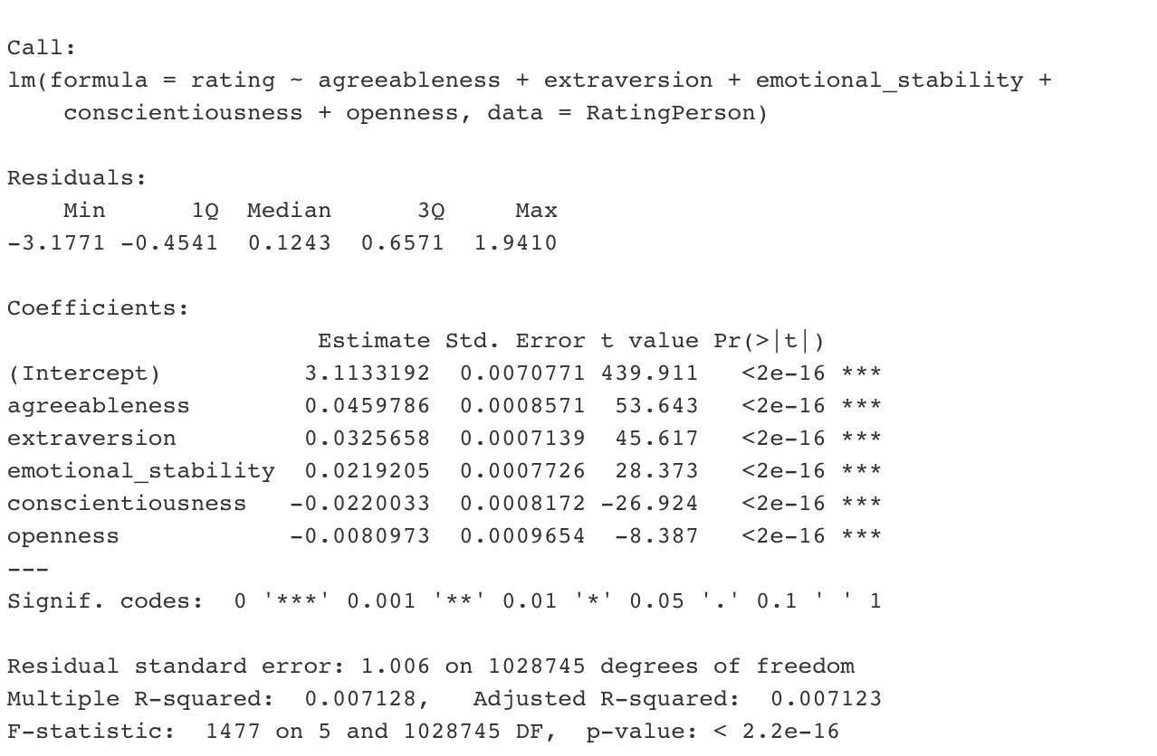
Predictive Models – Multiple Regression
Agreeableness trait produces best model out of all personality traits
Model using all personality traits has highest R^2 value, but is not statistically significant
Over five models were generated and none were able to explain the variability in user ratings

Slide 14
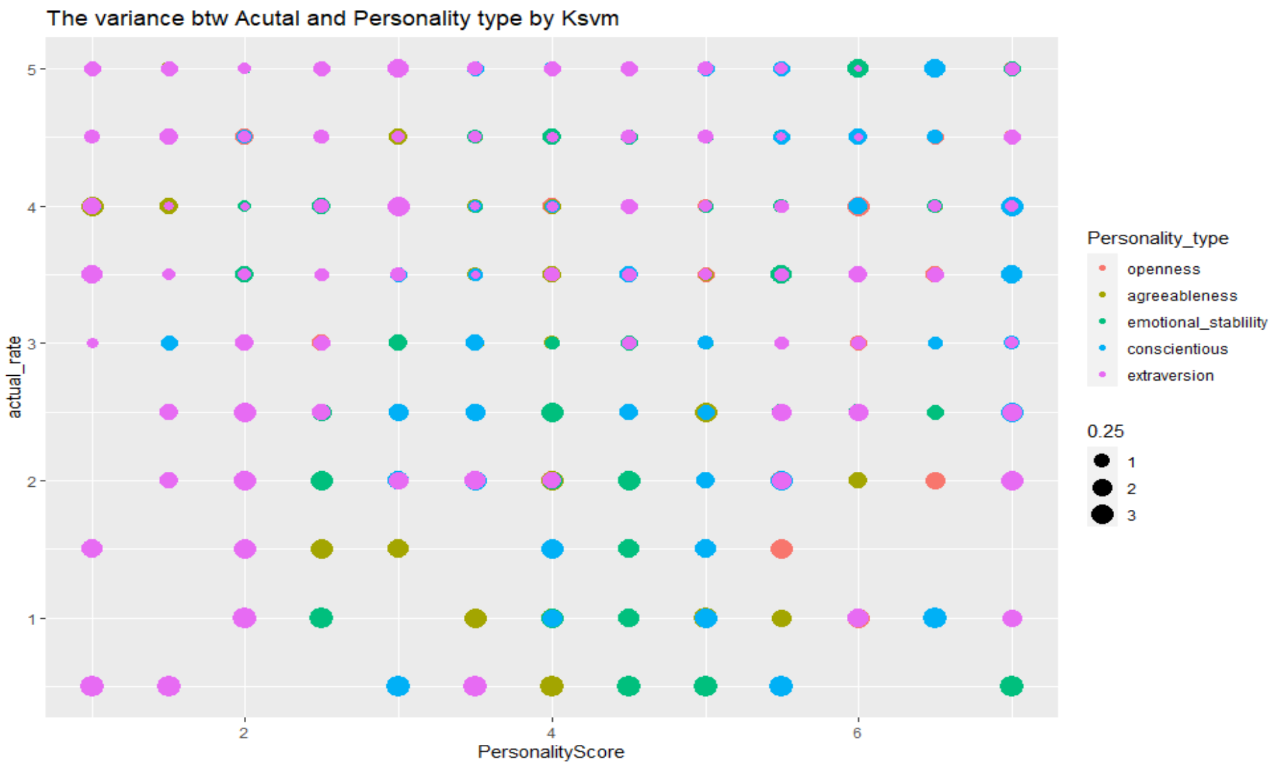
In this predicted model , I set x as Personality Score and y as actual rate. As you see, Extraversion is the majority variance and spread out each corner on the diagram. Second one is emotional stability and conscientious. However, this is not a good model to indicate the variance for each type of personality, so I separate each type of personality and make the predicted models again . The next slide will show the distribution of error for each type of personality

Slide 15
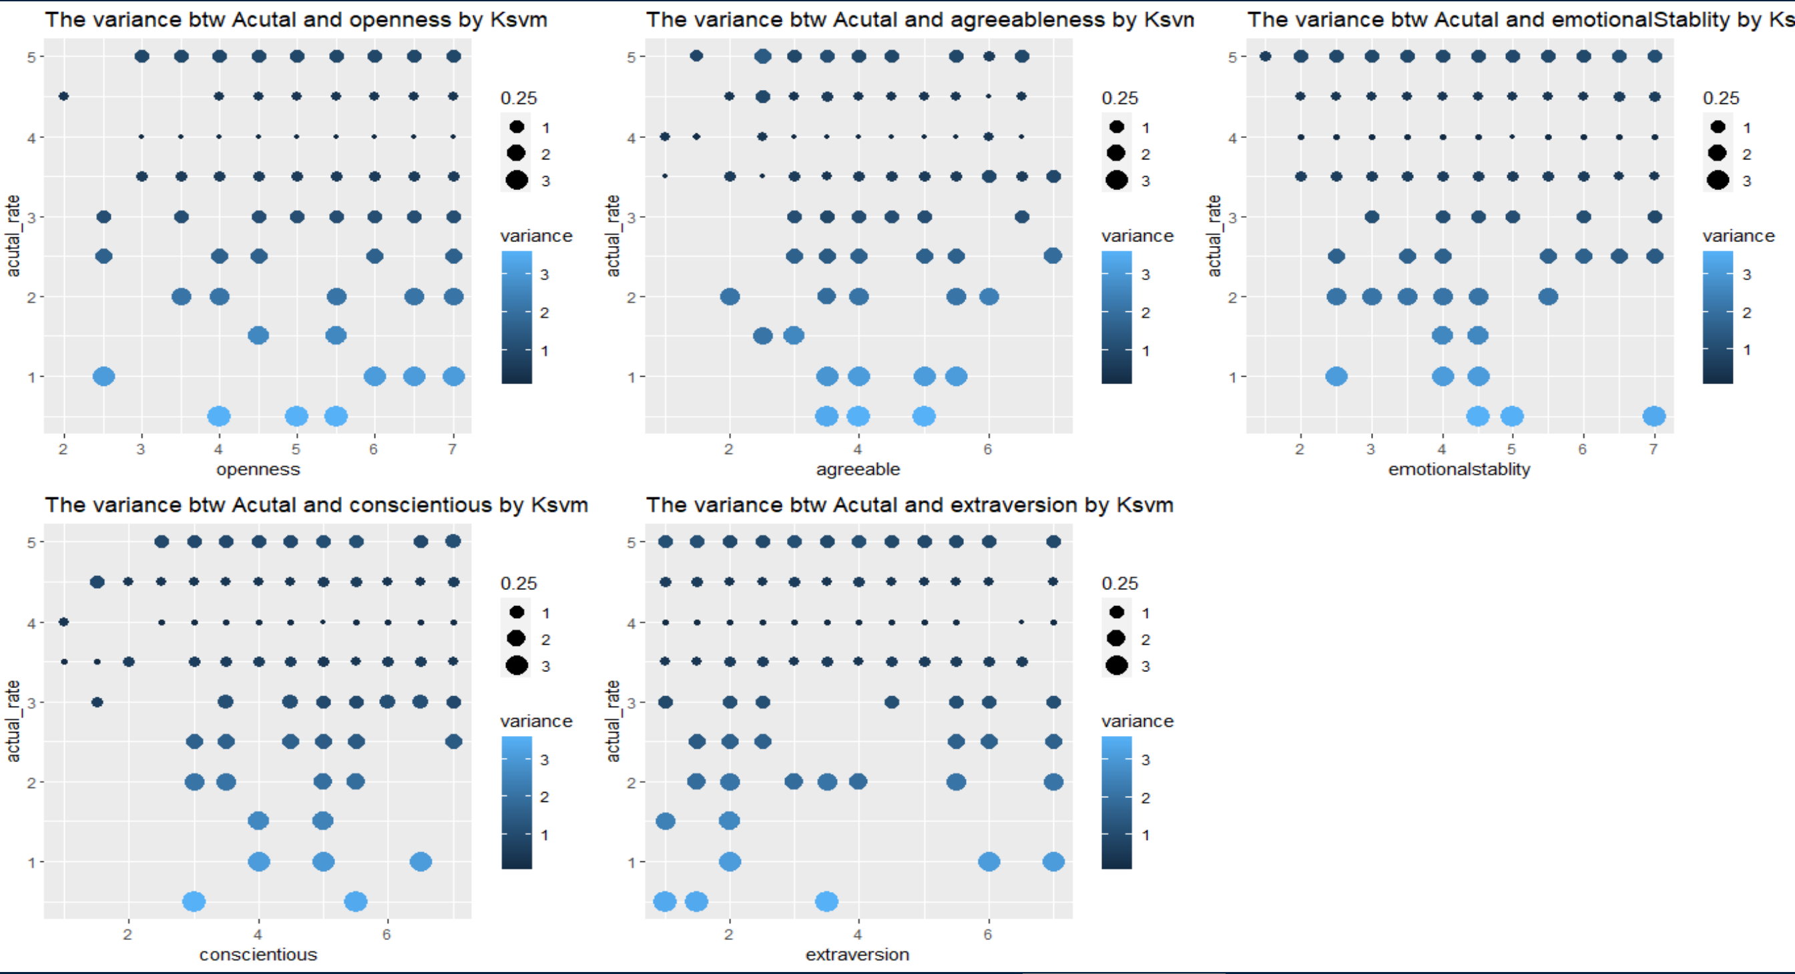
Notes:
#For the predicted model of each type of personality, we can see the larger variance of allocation is below average of actual rate. the less variance was spread on the top of diagram. These pattern is very similar for each type of personality.
For example: openness, it indicates users who openness score between 4 and 7 , their rating is closer to actual rate and less difference.
Thus,
As our record, there is an obvious Root Mean Squared Error, it indicate our model is not accuracy of predicated model. Thus, ksvm is not a good method to predict our model; however, we can recognize the allocation of each errors are similar and the majority of largest variance is distributed to below the average of actual rate.
[1] "As the error value of actual rate for predication(openness) : 1.00414842838872"
[1] "As the error value of actual rate for predication(agreeable) : 1.00404144556803"
[1] "As the error value of actual rate for predication(emotional stability) : 1.00477598553074"
[1] "As the error value of actual rate for predication(conscientiousness) : 0.987787639564209"
[1] "As the error value of actual rate for predication(extraversion) : 0.997852912694732"
[1] "As the error value of actual rate for predication2(openness agreeable) : 1.00960671168558"
[1] "As the error value of actual rate for predication3 : 1.09868475133293"

Slide 16
Conclusions
Personality test was able to separate users into distinct groups
Assigned metric and condition cannot explain variability in user satisfaction
None of the generated models could accurately predict user ratings
Original researchers were able to predict user ratings within 0.5 points
Notes:
For the dataset we chose, the authors of the study asked the question: What drives people’s choices in the movies they watch?

